Slide 1
Pygame Project: Simple Avoidance Game
A step-by-step guide with visuals

Slide 2
Introduction to the Game
This is a simple avoidance game created using Pygame.
The player controls a blue square and must avoid the red squares.
The goal is to survive as long as possible and achieve a high score.
The game features a main menu, a gameplay screen, and a game-over screen.

Slide 3
Main Menu Features :
The main menu has two options: Start and Quit.
Clicking 'Start' begins the game.
Clicking 'Quit' exits the game.
The interface is simple and user-friendly.

Slide 4
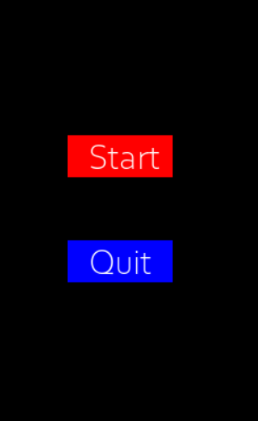
Main Menu Screen

Slide 5
Gameplay Mechanics :
The player controls a blue square using arrow keys.
Red squares move randomly, and the player must avoid them.
The score increases over time as the player survives.
The high score is recorded for comparison.

Slide 6
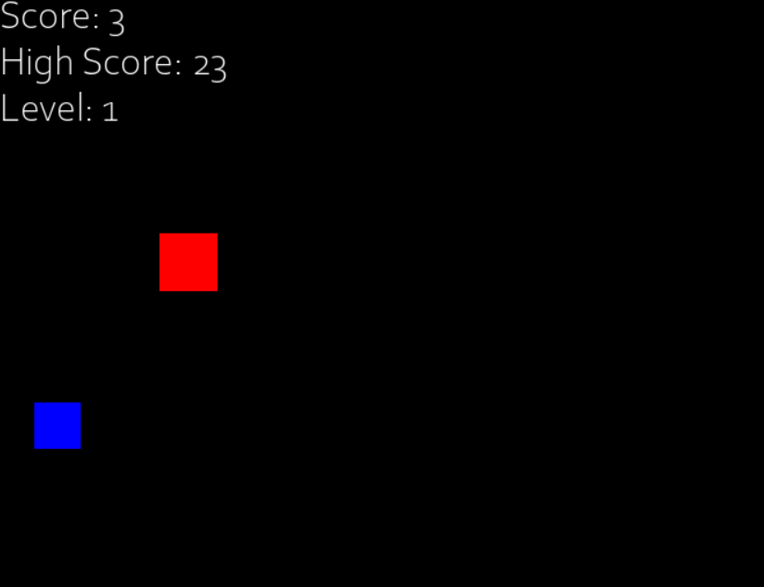
Gameplay Screen

Slide 7
Handling High Scores :
Read high score from a file:
with open('highscore.txt', 'r') as file:
high_score = int(file.read())
Update high score if needed:
if score > high_score:
with open('highscore.txt', 'w') as file:
file.write(str(high_score))

Slide 8
Enemy Movemen & Collision Detection :
Enemies move from right to left.
Randomized enemy spawn positions.
Collision is checked using Rect objects:
if player_rect.colliderect(enemy_rect): game_over()

Slide 9
Score & Level Progression :
Score increases when an enemy is passed.
Level increases every 5 points.
Higher levels increase enemy speed.
Display updated score, high score, and level.

Slide 10
Game Over Mechanics :
When the player collides with a red square, the game ends.
The final score and high score are displayed.
The player can press 'R' to retry or 'E' to exit.

Slide 11
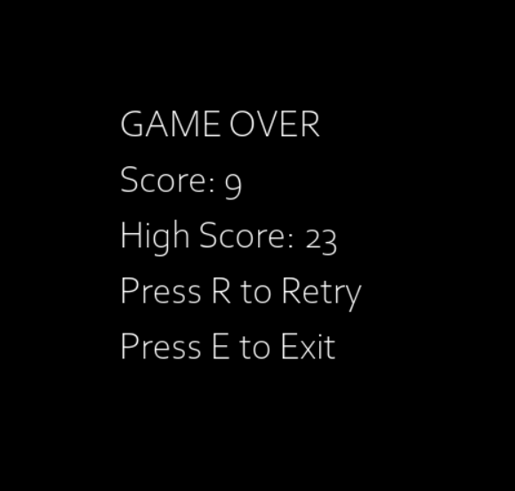
Game Over Screen

Slide 12
Key Features :
Simple but engaging gameplay.
High score tracking.
Intuitive user interface.

Slide 13
Possible Improvements :
Add sound effects and music.
Introduce power-ups and difficulty levels.
Enhance graphics and animations.

Slide 14
Conclusion & Summary :
Rendering graphics in Pygame.
Handling user input and game states.
Managing sound effects and music.
Implementing scoring, levels, and high scores.

Slide 15


